Slide 1
5th Intensive Workshop on Goods and Services Tax-Input Tax Credit
Speaker: Shivam Mehta, Executive partner
tanya garg, senior associate

Slide 2
Agenda (1/2)
Basic Understanding of Concept of Input Tax Credit
Key Conditions for Availment of ITC
Practical Issues
Non-Payment of Tax by Suppliers
New Restriction- Section 16(2)(ba)
Late filing of GSTR1 and/or GSTR3B by Supplier and GSTR 2A Matching
Payment of invoices within 180 days
Material amounts payable on milestones or satisfaction
Issues in Revival of ITC claim successfully
Part receipt of Goods, Services received in part/ lots,

Slide 3
Agenda (2/2)
ITC eligibility: Festival expenses, business gift items, Job Works, Motor Vehicle related supplies, Works Contract, Construction, P&M, Telecom towers and other issues
Taxability on Cancellation Charges of Hotel Bookings, Flight Ticketing etc
ITC Eligibility and Planning in Rentable Assets like Shopping Mall, Commercial Buildings, Hotels etc.
Effect of discount
ITC of GST paid under protest or voluntarily at time of survey or search
Cross Charge vs ISD
Reversals under Rule 42 and Rule 43

Slide 4
Basic Understanding and Concept of Input Tax Credit

Slide 5
Eligibility for availing ITC - Section 16(1)
Every registered person shall,
subject to such conditions and restrictions as may be prescribed and in the manner specified in section 49,
be entitled to take credit of input tax charged on any supply of goods or services or both to him
which are used or intended to be used
in the course or furtherance of his business
and the said amount shall be credited to the electronic credit ledger of such person.

Slide 6
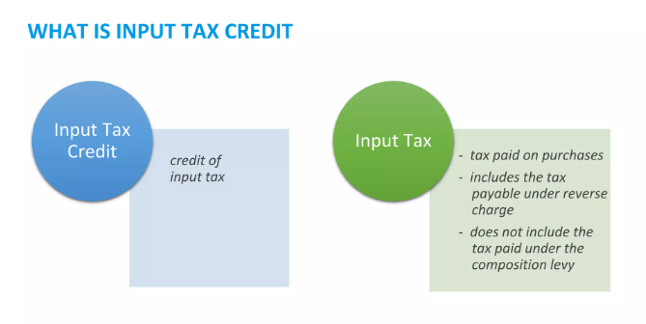
Input Tax Credit

Slide 7
Definitions
(19) “capital goods” means goods, the value of which is capitalised in the books of account of the person claiming the input tax credit and which are used or intended to be used in the course or furtherance of business;
(59) “input” means any goods other than capital goods used or intended to be used by a supplier in the course or furtherance of business;
(60) “input service” means any service used or intended to be used by a supplier in the course or furtherance of business;

Slide 8
Capitalisation of Assets
CAPITAL ASSETS
ITC AVAILABLE IN RESPECTIVE STATES?
BO Andhra Pradesh
BO Orissa​
BO Rajasthan
ITC
ITC
ITC
CAPITALISATION AT Head Office-Haryana
Invoice
Invoice
Invoice

Slide 9
Key Conditions for Availment of ITC

Slide 10
Availing ITC - Conditions
Availment
10
7
1
No Credit beyond specified period
Possession of tax invoice
Time Limits
(E.g. FY 22-23)
Earliest of:
30th November
Filing of Annual Return for FY 22-23
6
Returns are filed appropriately
Limiting
factors
Receipt of Goods/Services
2
Payment to supplier within 180 days
ITC on last Lot/ Installment
5
Tax is paid to
the Government
3
GSTR 2B reconciliations
4

Slide 11
Extension of timeline for availment of ITC
Hurray!!
Earlier timeline
ITC availment by 20th October
i.e., in the returns filed for the month of September
Extended Timeline w.e.f. 01.10.2022
ITC availment by 30th November
1 month extension
Notified vide Notifications 18/2022- central tax, dated. 28.09.2022
Notes:
Notification 18/2022

Slide 12
Extension of time limit to avail ITC
(4) A registered person shall not be entitled to take input tax credit in respect of any invoice or debit note for supply of goods or services or both after the due date of furnishing of the return under section 39 for the month of September thirtieth day of November following the end of financial year to which such invoice or debit note pertains or furnishing of the relevant annual return, whichever is earlier.
The time-limit to avail ITC has been extended to 30th November of the next Financial Year (FY)
Issue
Whether ITC can be taken by the due date of filing GSTR-3B for November following the end of FY to which invoice/ debit note pertains?
Whether time period for availment of ITC to be seen from date of debit note?
Whether above condition applicable to tax paid under RCM?
Whether above condition applicable in case of imports?

Slide 13
Constitutional Validity- Challenged
Section 16(2)(c)- Bharti Telemedia Ltd, Cummins Technologies Pvt. Ltd.
Rule 36(4)- LGW Industries Ltd, GR Infraprojects Ltd. etc.
Evolving Restrictions in claiming ITC
Introduction of GST (July 2017)
Mismatching Principle Envisaged
Section 16(2)(c)- only restriction
Matching with GSTR-2A/2B
Rule 36(4) introduced w.e.f. 09.10.2019
Benefit of buffer of 20%/10%/5%
Section 16 (2)(aa)
Validity to Rule 36(4)
w.e.f. 01.01.2022
WHAT’S NEXT?

Slide 14
Non-payment of tax by supplier

Slide 15
Section 16(2)(c)-Introduction of GST
(c) subject to the provisions of section 41, the tax charged in respect of such supply has been actually paid to the Government, either in cash or through utilisation of input tax credit admissible in respect of the said supply;
Already challenged before Different High Courts (Around 34 writ petitions filed)
Bharti Telemedia Limited (Delhi HC)
Cummins Technologies Pvt Ltd (Madhya Pradesh HC)
LGW Industries Limited (Calcutta HC)
No control over the seller to ensure that such tax is deposited with the Government
Provision in violation with Article 14
Transfer petition filed before Supreme Court dismissed
Notes:
Bharti Telemedia Limited
In Re_ M_s. Cummins India Limited
LGW Industries Limited (Calcutta HC)

Slide 16
Tax is paid to Government?- Bombay High Court
Mahalaxmi Cotton Ginning Pressing And Oil Industries, Kolhapur Versus State of Maharashtra & Ors.
MVAT Act: Section 48(5) provides that for the removal of doubt it is hereby declared that, in no case the amount of set off or refund on any purchase of goods shall exceed the amount of tax in respect of the same goods, actually paid, if any, under this Act or any earlier law, into the Government Treasury except to the extent where purchase tax is payable by the Claimant dealer on the purchase of the said goods effected by him:
Decision: Article 14 not offended. Section 48(5) constitutionally valid
Notes:
4. Mahalaxmi Cotton Ginning Pressing And Oil Industries,

Slide 17
Tax is paid to Government?- Delhi High Court
On Quest Merchandising India Pvt. Ltd. Versus Govt.
DVAT Act: Section 9(2)(g) specifies ITC shall not be allowed to the dealers or class of dealers unless the tax paid by the purchasing dealer has actually been deposited by the selling dealer with the Government or has been lawfully adjusted against output tax liability and correctly reflected in the return filed for the respective tax period.
Decision:
Article 14 cited. Section 9(2)(g) to be read down to exclude a bona-fide purchasing dealer.
Affirmed by Supreme Court in Arise India
Notes:
5. Quest Merchandising India Pvt. Ltd. Versus Govt.

Slide 18
Tax is paid to Government?- Delhi High Court
On Arise India Ltd. vs Commissioner of Trade and Taxes, Delhi
Decision:
The Delhi High Court followed the decision of Hon’ble Punjab and Haryana High Court in the case of Gheru Lal Bal Chand v. State of Haryana^{[2]} and held that ITC cannot be denied to a bonafide purchaser even if the selling dealer has not deposited the tax with the Government.
SLP Filed before Supreme Court Dismissed
Notes:
6. Arise India Ltd. vs Commissioner of Trade and Taxes, Delhi 6A. Gheru Lal Bal Chand v. State of Haryana

Slide 19
Burden on claimant of ITC
SECTION 155. Burden of proof. — Where any person claims that he is eligible for input tax credit under this Act, the burden of proving such claim shall lie on such person.
Ecom Gill Coffee Trading Private Limited- Recent Supreme Court Decision
Decision of Quest Merchandising distinguished.
Burden of proving the correctness of credit- upon dealer and cannot get shifted on the revenue.
Mere production of the invoices or the payment made by cheques not enough
Dealer to furnish name and address of the selling dealer, details of the vehicle which has delivered the goods, payment of freight charges, acknowledgement of taking delivery of goods, tax invoices and payment particulars etc.
Genuineness of the transaction and actual physical movement of the goods to be proved
Decision of Supreme Court followed by Madras High Court in case of Tvl Sahyadri Industries Ltd.
Notes:
7. Ecom Gill Coffee Trading Private Limited

Slide 20
Ecom Gill Coffee Trading Private Limited
Relevant Points to discuss:
Applicability of decision in case of services?
Documents to be submitted for receipt of services?
Whether support can still be drawn from the case of Quest Merchandising India Pvt. Ltd. Versus Govt.?

Slide 21
Madras HC- Tvl Sahyadri Industries Ltd.
Tests laid down by High Court
The valid & original purchase invoice, issued by the selling dealer to establish the transfer of title of goods.
The proof for bank or cash payment of the proceed, made against the consideration to establish the rights on transfer of title of goods.
Proof of transportation to establish the transfer of possession of goods.
Notes:
7. Ecom Gill Coffee Trading Private Limited

Slide 22
External Environment
SCAM
Stringent provisions for grant of registration to only bonafide applicants
Extensive sharing of information –(GSTN notified for sharing of information by Financial Intelligence Unit under PMLA)
Special All-India Drives to detect suspicious / fake GSTINs
More than 500 arrests made by DGGI after unearthing fake invoices

Slide 23
Recent investigations & potential disputes
Other Probable disputed areas
Promotional service invoices received from distributors
Transfer of credit between distinct persons

Slide 24
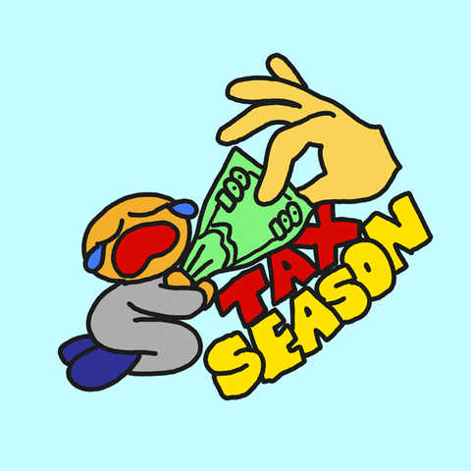
Section 41- Non-payment of tax by the supplier
Provisional ITC
Self Assessed ITC
Reversal along with Interest
Re-availment on payment of tax by supplier

Slide 25
Amendment in Section 41
Availment of input tax credit
41. (1) Every registered person shall, subject to such conditions and restrictions as may be prescribed, be entitled to avail the credit of eligible input tax, as self-assessed, in his return and such amount shall be credited to his electronic credit ledger.
(2) The credit of input tax availed by a registered person under sub-section (1) in respect of such supplies of goods or services or both, the tax payable whereon has not been paid by the supplier, shall be reversed along with applicable interest, by the said person in such manner as may be prescribed:
Provided that where the said supplier makes payment of the tax payable in respect of the aforesaid supplies, the said registered person may re-avail the amount of credit reversed by him in such manner as may be prescribed.

Slide 26
Reasons for Amendment
43rd Council Meeting
Sub-section 1: Amendment to do away with the word ―claim and bring in the concept of availment; and also, to remove the concept of provisional availment of ITC in this section. The concept of provisional availment was there in GSTR-1/2/3 model.
Sub-section 2: May be removed as the said requirement is already flowing from Section 49.
Budget Memorandum
Section 41 of the CGST Act is being substituted so as to do away with the concept of “claim” of eligible input tax credit on a “provisional” basis and to provide for availment of self-assessed input tax credit subject to such conditions and restrictions as may be prescribed.

Slide 27
Rule 37A
Where input tax credit has been availed by a registered person in the return in FORM GSTR-3B for a tax period in respect of such invoice or debit note, the details of which have been furnished by the supplier in the statement of outward supplies in FORM GSTR-1 or using the invoice furnishing facility, but the return in FORM GSTR-3B for the tax period corresponding to the said statement of outward supplies has not been furnished by such supplier till the 30th day of September following the end of financial year in which the input tax credit in respect of such invoice or debit note has been availed, the said amount of input tax credit shall be reversed by the said registered person, while furnishing a return in FORM GSTR-3B on or before the 30th day of November following the end of such financial year:
Provided that where the said amount of input tax credit is not reversed by the registered person in a return in FORM GSTR-3B on or before the 30th day of November following the end of such financial year during which such input tax credit has been availed, such amount shall be payable by the said person along with interest thereon under section 50.
Provided further that where the said supplier subsequently furnishes the return in FORM GSTR-3B for the said tax period, the said registered person may re-avail the amount of such credit in the return in FORM GSTR-3B for a tax period thereafter

Slide 28
Illustration-Rule 37A
In which GSTR-3B are the invoices/debit notes reported by the supplier? | Do buyers need to reverse ITC?
Supplier filed GSTR-3B on or before 30th September 2023. | No need to reverse the ITC claimed earlier.
Supplier filed GSTR-3B on or after 1st December 2023. | Yes, ITC earlier claimed must be reversed in GSTR-3B | Buyer filed GSTR-3B is filed on or before 30th November 2023.
 |  | Buyer filed GSTR-3B is filed on or after 1st December 2023.- Whether time limit prescribed under Section 16(4) applicable?

Slide 29
Section 41 : Non-payment of tax by the supplier
Issues:
Portal methodology for communicating details of non-payment of tax by supplier and subsequent payment thereof?
Can bonafide buyer plead ignorance of supplier’s failure to pay tax?
Interest applicable on ITC availed but not utilized?
Earlier arguments taken for challenging Section 16(2)(c) have become redundant?
Similar condition under Section 16(2)(c) is already under challenge before Delhi HC (Bharti Telemedia Ltd.)

Slide 30
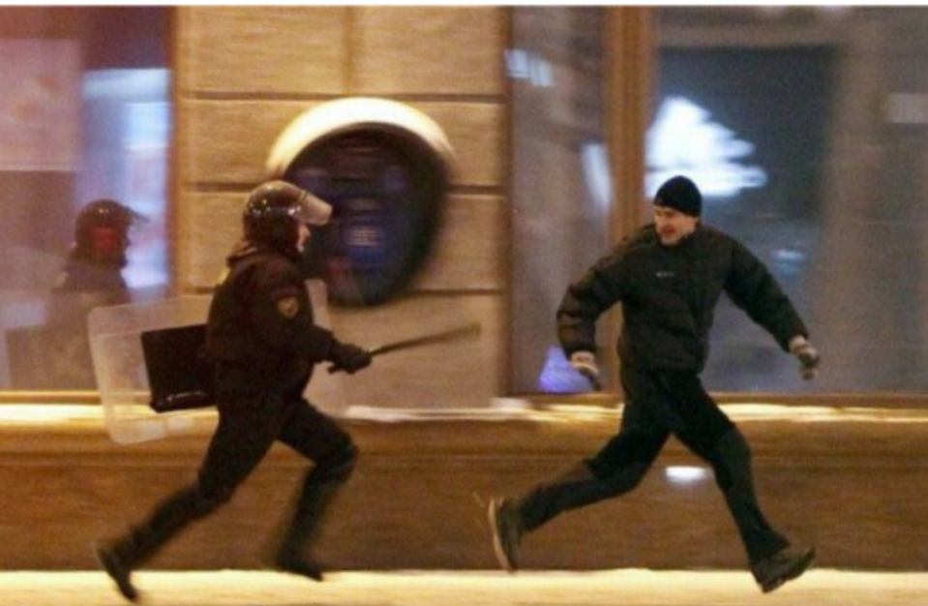
To avail credit or to re-avail it- what do we do?

Slide 31
New Restriction- Section 16(2)(ba)

Slide 32
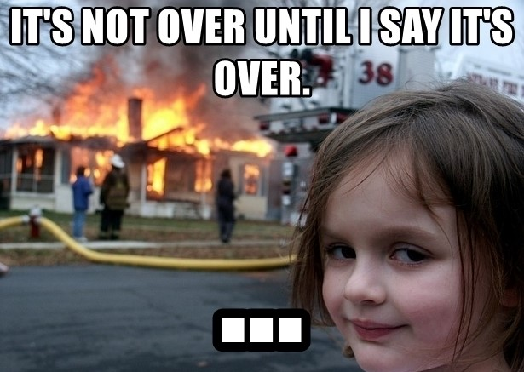
Section 16(2)(ba) read with Section 38 - Still more to come?

Slide 33
Earlier Restrictions imposed vide GSTR-2B
Invoice or debit note for supply of goods or services or both where the recipient is not entitled to input tax credit as per the provisions of Section 16(4) of the CGST Act.
Invoice or debit note where the supplier (GSTIN) and place of supply are in the same state while recipient is in another state
However, there may be other scenarios for which input tax credit may not be available to the taxpayers and the same has not been generated by system. Taxpayers, should self-assess and reverse such credit in their Form GSTR-3B

Slide 34
Section 16(2)(ba): New Condition imposed
New condition for availment of credit – Not restricted under Section 38. [Section 16(2)(ba)]
“the details of input tax credit in respect of the said supply communicated to such registered person under Section 38 has not been restricted”
Section 38 substituted. New Section 38 provides that the following shall be made available to the recipients.
Auto generated statement (GSTR-2B) containing details of ITC
Details furnished by the registered persons under Section 37(1)
Other supplies as may be prescribed
Enabling provision for GSTR 2B
Such statement will contain details of inward supplies in respect of which ITC may be available to recipient [Section 38(2)(a)]

Slide 35
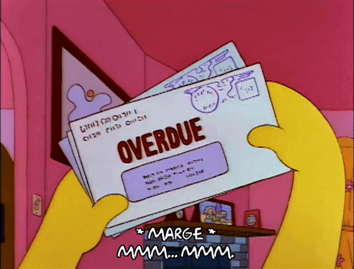
Section 38(2)(b)
Conditions to be fulfilled by Supplier-Default by Supplier
Disallowance to Recipient

Slide 36
Section 38(2)(b)
Clause | Condition | Documents
(i) | Within such period of taking registration | -
(ii) | Defaulted in payment of tax and such default has continued for prescribed period | Non-payment in GSTR-3B
(iii) | Output tax payable in accordance with the statement of outward supplies exceeds the output tax paid by him by prescribed limit | Comparison of GSTR-1 & GSTR-3B of supplier
(iv) | Availed ITC that exceeds the ITC that can be availed by him in accordance with clause (a), by prescribed limit | Comparison of GSTR-3B & GSTR-2B of supplier
(v) | Defaulted in discharging his tax liability in accordance with provisions of Section 49(12) | Cash payment of 1% not made
(vi) | such other class of persons as prescribed | -

Slide 37
Reasons for Amendment
43rd Council Meeting
The present sub-sections to be omitted in entirety as there is no requirement of furnishing details of inward supplies by the taxpayer.
The new section to provide that details of inward supplies shall be made available to the recipients in a prescribed manner. This is essentially an enabling provision to provide for GSTR-2B. The requirement of reversal of input tax credit arises from Chapter V, and is, therefore, not required to be mentioned under this section.
Further, provision to implement spike rules is incorporated in sub-section (2).
Budget Memorandum
Section 38 of the CGST Act is being substituted for prescribing the manner as well as conditions and restrictions for communication of details of inward supplies and input tax credit to the recipient by means of an auto-generated statement and to do away with two-way communication process in return filing.

Slide 38
Late filing of GSTR-1 and/ or GSTR-3B by Supplier and Mismatch

Slide 39
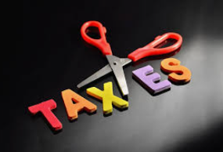
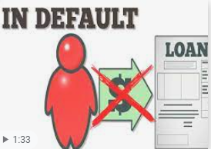
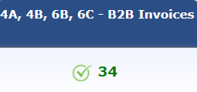
Current Issues: Trouble for Genuine Taxpayers
Default By Supplier
ITC Denial/ Reversal of ITC
Interest Demanded
To Bonafide
recipient
GENUINE BUYERS
GSTR-1: All invoices reported in return
GSTR-3B: No Tax Paid but Return Filed
GSTR-3B: No Tax Paid

Slide 40
Section 16(2)(aa) introduced
(aa) the details of the invoice or debit note referred to in clause (a) has been furnished by the supplier in the statement of outward supplies and such details have been communicated to the recipient of such invoice or debit note in the manner specified under section 37.
introduced w.e.f. 01..01.2022
Validity to Rule 36(4)

Slide 41
Amendment in Rule 36(4)
(4) No input tax credit shall be availed by a registered person in respect of invoices or debit notes the details of which are required to be furnished under sub-section (1) of section 37 unless,-
(a) the details of such invoices or debit notes have been furnished by the supplier in the statement of outward supplies in FORM GSTR-1 or using the invoice furnishing facility; and
(b) the details of input tax credit in respect of such invoices or debit notes have been communicated to the registered person in FORM GSTR-2B under sub-rule (7) of rule 60
.
introduced w.e.f. 01.01.2022
No Buffer
Matching with GSTR-2B

Slide 42
LEGISLATIVE PROVISIONS​
ITC availed on self-assessment basis, on fulfilment of conditions prescribed under Section 16​
Date​ | Availment of ITC​
Prior 09.10.2019​ | No mandate for availing ITC based on invoices reflecting in GSTR-2A​
09.10.2019​ | Notification No. 49/2019-CT ​ Condition to avail ITC based on amounts populating in Form GSTR-2A ​ 20% of eligible credit of invoices appearing in purchase register, over and above 2A could be availed​
26.12.2019​ | Notification No. 75/2019-CT​ Relaxation reduced to 10% w.e.f 01.01.2020​
22.12.2020​ | Notification No. 94/2020-CT​ Relaxation reduced to 5% w.e.f 01.01.2021​
29.12.2021. ​ ​ | Notification No. 40/2021-CT​ 100% matching of GSTR-2B & 3B mandated w.e.f 01.01.2022 ​

Slide 43
Different Scenarios
GSTR-1 filed? | GSTR-3B Filed? | Implications
Yes | No | Section 16 (2)(c) What if filed later on?
No | Yes | Section 16(2)(aa) What if filed subsequently- Difference between GSTR 2B and GSTR3B? Section 16(4)- if filed after 30th November?
No | No | ITC?

Slide 44
Circular No. 183/15/2022-GST Dated 27.12.2022​
The procedure for verification of ITC in cases involving difference in ITC availed in FORM GSTR-3B vs. ITC available as per FORM GSTR-2A during FY 2017-18 and 2018-19​
Reason for non-reflection in GSTR-2A​ | Manner of Verification​
Supplier failed to file GSTR-1 but filed GSTR-3B ​ | Fulfillment of conditions prescribed under Section ​16 for invoices not reflecting in GSTR-2A​ Possession of Tax invoice/ Debit Note​ Received Goods and/or Service ​ Recipient has made payment​ Compliance with Section 16(2) (c) i.e., payment of ​ tax by supplier​ If difference is > 5 Lakhs – CA Certificate ​ If difference is < 5 Lakhs – Certificate from ​ Supplier​
Supplier filed GSTR-1 and GSTR-3B but failed to report the particular supply​
Invoice wrongly reported as B2C instead of B2B​
Mentioned wrong GSTN​
Notes:
10. Circulars - 183_15_2022 dated - 27 December 2022

Slide 45
CIRCULAR NO. 193/05/2023-GST DATED 17.07.2023
Period​ | Rule 36(4)​ | Manner of verification ​
Apr 2019 to Sept 2019 ​ | Rule 36(4) not in force.​ | The guidelines provided by Circular dated 27th ​ December 2022 shall be applicable in toto. ​
Oct 2019 to Dec 2019​ | Rule 36(4) allowed ITC in respect of invoices not available in GSTR-2A to the extent of 20% of eligible credit available in GSTR-2A.​ | The guidelines provided by Circular dated 27th ​ December 2022 will be restricted to the extent ​ of 20%​
Jan 2020 to Dec 2020​ | Relaxation reduced to 10%​ | The guidelines provided by Circular dated 27th ​ December 2022 will be restricted to the extent ​ of 10%​
Jan 2021 to Dec 2021​ | Relaxation reduced to 5%​ | The guidelines provided by Circular dated 27th ​ December 2022 will be restricted to the extent ​ of 5%​
Guidelines applicable for ongoing proceedings in audit, investigation, adjudication or appeal
Notes:
11. Circulars - 193_05_2023-GST dated - 17 July 2023

Slide 46
ILLUSTRATION
Particular​ | Amount (in Rs.) ​
ITC available in GSTR-2A ​ | 3,00,000/-​
ITC availed in GSTR-3B​ | 5,00,000/-​
ITC eligible as Rule 36(4) [3,00,000 * 1.2%]​ | 3,60,000/-​
ITC allowed subject to production of requisite certificate ​ | 60,000/-​
ITC not admissible in terms of Rule 36(4)​ | 1,40,000/-​
Credit not available beyond limit specified in Rule 36(4)

Slide 47
Payment of Invoices within 180 days

Slide 48
Second Proviso to Section 16(2) of the CGST Act
‘where a recipient fails to pay to the supplier of goods or services or both, other than the supplies on which tax is payable on reverse charge basis, the amount towards the value of supply along with tax payable thereon within a period of one hundred and eighty days from the date of issue of invoice by the supplier, an amount equal to the input tax credit availed by the recipient shall be added to his output tax liability, along with interest thereon, in such manner as may be prescribed’.

Slide 49
Rule 37: Reversal of ITC in the case of non-payment of consideration
(1) A registered person, who has availed of input tax credit on any inward supply of goods or services or both, other than the supplies on which tax is payable on reverse charge basis, but fails to pay to the supplier thereof, the amount towards the value of such supply whether wholly or partly, along with the tax payable thereon, within the time limit specified in the second proviso to sub-section(2) of section 16, shall pay or reverse an amount equal to the input tax credit availed in respect of such supply proportionate to the amount not paid to the supplier, along with interest payable thereon under section 50, while furnishing the return in FORM GSTR-3B for the tax period immediately following the period of one hundred and eighty days from the date of the issue of the invoice:
Provided that the value of supplies made without consideration as specified in Schedule I of the said Act shall be deemed to have been paid for the purposes of the second proviso to sub-section (2) of section 16:
Provided further that the value of supplies on account of any amount added in accordance with the provisions of clause (b) of sub-section (2) of section 15 shall be deemed to have been paid for the purposes of the second proviso to sub-section (2) of section 16.

Slide 50
Rule 37 (Cont.)
(2) Where the said registered person subsequently makes the payment of the amount towards the value of such supply along with tax payable thereon to the supplier thereof, he shall be entitled to re-avail the input tax credit referred to in sub-rule (1).
(4)The time limit specified in sub-section (4) of ​section 16 shall not apply to a claim for re-availing of any credit, in accordance with the provisions of the Act or the provisions of this Chapter, that had been reversed earlier.

Slide 51
No payment has been made by the assessee to the supplier within a period of 180 days from the date of issuance of invoice by supplier
Reverse credit
Interest payable?
Payment has been made by the assessee to the supplier after a period of 180 days from the date of issuance of invoice by supplier
ITC Reversal?
A portion of payment of supplier is withheld by the querist for more than 180 days.
Whether Proportionate Reversal?
Applicability of Interest?
Applicability of Interest?
Notes:
12. HG Infra

Slide 52
Retention Money
Restriction of Section 16(2) is applicable on the retained value?
Whether it qualifies to failure to pay?
Value of Supply paid in installments | Value paid to the Government | Value paid by Recipient to supplier | Value retained by recipient
100 | 100 | 90 | 10
100 | 100 | 90 | 10
100 | 100 | 90 | 10
Notes:
13. Retention Money Mail

Slide 53
ISSUES IN REVIVAL OF ITC CLAIM

Slide 54
Availment of Credit
Reversal of Credit
Re-availment of credit?
Re-availment of credit
October 2020
December 2020
April 2023?
Time Limit under Section 16(4) applies on re-availment of ITC?

Slide 55
Section 41 : Non-payment of tax by the supplier
On Mahindra & Mahindra Ltd. (Automotive sector) , versus Union of India
The Bombay HC while relying on several Supreme Court judgments held that the liability to interest and penalty is substantive and that provisions imposing interest and penalty are substantive (and not machinery)
No interest and penalty can be levied on the portion of payment pertaining to surcharge, countervailing duty (CVD) and special additional duty (SAD).
Affirmed by the Supreme Court
Notes:
9. Mahindra & Mahindra

Slide 56
Material amounts payable on milestone/ satisfaction

Slide 57
Time of Supply
Section 13(2) of the CGST Act,
(2) The time of supply of services shall be the earliest of the following dates, namely :—
(a) the date of issue of invoice by the supplier, if the invoice is issued within the period prescribed under section 31 or the date of receipt of payment, whichever is earlier; or
(b) the date of provision of service, if the invoice is not issued within the period prescribed under section 31 or the date of receipt of payment, whichever is earlier; or
(c) the date on which the recipient shows the receipt of services in his books of account, in a case where the provisions of clause (a) or clause (b) do not apply.

Slide 58
Time of Supply- 31(5)
Tax Invoice to be raised in case of continuous supply of services–– Section 31(5) of CGST Act
where the due date of payment is ascertainable from the contract, the invoice shall be issued on or before the due date of payment;
where the due date of payment is not ascertainable from the contract, the invoice shall be issued before or at the time when the supplier of service receives the payment;
where the payment is linked to the completion of an event, the invoice shall be issued on or before the date of completion of that event
Notes:
Meaning of continuous supply of services (Section 2(33) of the CGST Act)
“a supply of services which is provided, or agreed to be provided, continuously or on recurrent basis, under a contract, for a period exceeding three months with periodic payment obligations and includes supply of such services as the Government may, subject to such conditions, as it may, by notification, specify”

Slide 59
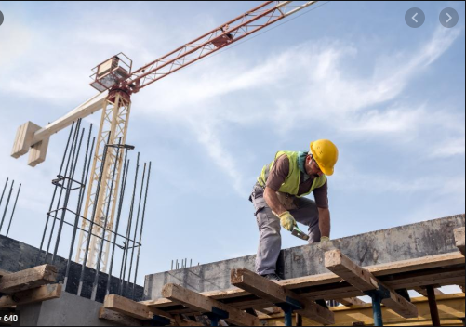
Time of Supply- Payment Based
Contract for
Construction of Site
Due Date of Payment based on milestone
basis
10%
35%
10 Lac
45 Lac
Time of Supply?
Availability of ITC?
Payment on the basis of Milestones

Slide 60
Part receipt of Goods, Services received in Parts/ Lots

Slide 61
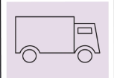
Goods Received in LOTS
ITC Availability on Last Lot
Lot 1
Lot 2
Last Lot

Slide 62
Goods Received on Achievement of targets
Whether ITC on main product admissible on receipt of free product?

Slide 63
Blocked Credits

Slide 64
Section 7(1)(c): Supplies without Consideration
Activities specified in Schedule 1
Made or agreed to be made
Without a consideration

Slide 65
Transactions b/w employer & employees
In terms of proviso to para-2 of the Schedule-I of the CGST Act, gifts not exceeding fifty thousand rupees in value in a financial year by an employer to an employee shall not be treated as supply of goods.
Press Release 73/2017 dated 10.07.2017 and Circular
Services are provided free of charge to all the employees by the employer then the same will not be subjected to GST,
Services/goods is provided in terms of the contract between the employer and employee and is part and parcel of the cost-to-company (C2C) will not be subject to GST.
Notes:
15. Press Release 73/2017

Slide 66
ITC Not Available
Section 17(5)(h)
goods lost, stolen, destroyed, written off or disposed of by way of gift or free samples; and
Section 17(5)(g)
goods or services or both used for personal consumption;
Schedule I- Activities to be treated as supply even if made without consideration
Permanent transfer or disposal of business assets where input tax credit has been availed on such assets.

Slide 67
Gifts
What is gift?
Section 122 of Transfer of Property Act, 1882, “Gift” is the transfer of certain existing moveable or immoveable property made voluntarily and without consideration
Australian GSTR 2001/ 06 :- Unconditional incentives and promotional giveaways. ………, ‘a non-monetary payment is sometimes made by an entity (such as a manufacturer) to induce another party to make or continue to make purchases from the entity. Where the payment is truly unconditional (that is, a gift), it is not consideration for a supply by that other party.
Notes:
UK VAT Notice 700/7, ‘business gift is a gift of goods that is made in the course of your business and for which you were entitled to reclaim the VAT that were charged on its purchase as input tax. It covers a wide range of items from brochures, posters and advertising matter to expensive goods of the kind given as ‘executive presents’.
Supply Guide under Malaysian GST Law: Examples of gift for business purposes are:
(a) ceramic mug given to customer who purchased more than RM200 worth of goods at a retail outlet.
(b) diary and calendars to customers and public.

Slide 68
Gifts
The Black Law Dictionary defines “gift” as a “voluntary conveyance of land, or transfer of goods, from one person to another, made gratuitously, and not upon any consideration of blood or money.”
According to Merriam Webster Dictionary, the meaning of gift is, “something voluntarily transferred by one person to another without compensation; the act, right, or power of giving.”

Slide 69
Products Given To Employees/Distributors
Festival Expenses Such As TV, Washing Machine etc
Business Gifts
Materials like banners, posters, stickers etc. given to retailers/shopkeepers for displaying in their shops
Diaries, Pens, calendars, t-shirts distributed.

Slide 70
Promotional Items/ Gifts/ Incentives
Manufacturer
Distributor
Retailer
Customer
Mug with company logo given to retailer on attaining a purchase target
Foreign trip given to retailer on attaining a purchase target
Calendars, Diaries etc. given without condition
Export of samples to related and non related persons
Promotional items supplied with the obligation on dealer to perform certain activity in return.

Slide 71
Service as a gift?
Opinion of Advocate General in Kuwait Petroleum v. Commissioners of Customs & Excise dated 9th July, 1998
“25. Secondly, it is difficult to avoid the conclusion that the contrasting treatment of services by Article 6(2)(b) of the Sixth Directive is deliberate. Without wishing to speculate, I suggest that among the obvious differences between goods and services is that services do not lend themselves, at least not so readily, to free promotion schemes. The more significant labour content would presumably reduce capacity for mass supply of free services. Thus, it seems likely that the disparity in the wording of the two provisions was deliberate.”
Notes:
Kuwait Petroleum

Slide 72
Service as a gift?
Associated Newspapers Limited and The Commissioners for her Majesty’s Revenue and Customs (2017 EWCA Civ. 54)
“62. Against that background, I can now turn to the specific criticisms made by HMRC in relation to the FtT’s decision about the applicability of Article 3. The main issues are how to interpret Article 26 and whether it imposes a strict test of necessity which excludes anything (such as the vouchers) that are not necessary for the running of ANL’s business.
63. One can begin with the wording of Article 26 compared with that of Article 16. In the case of goods, Article 16 imposes output tax on any free supply of goods comprising business assets apart from goods supplied as business samples or gifts of small value. A free supply of goods not in these categories will be treated as a supply for consideration and therefore a taxable supply even if made for business purposes. The wording of Article 26 is, however, materially different and treats as a taxable supply only supplies of services:
“carried out free of charge by a taxable person for his private use or for that of his staff or, more generally, for purposes other than those of his business.”
64. The words “carried out free of charge ….. for” qualify all of the specified uses which follow and Articles 3 and 6 of the 1993 Order are to the same effect.”
Notes:
17. HMRC-v-Associated-Newspapers

Slide 73
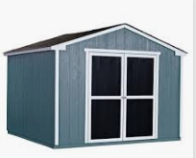
Expired Stock
Goods sold to Dealers
Manufacturer Premises
Dealer Premises- Stock Expired

Slide 74
Expired Stock
Compensation given in respect of expired Stock
Scrapped the Goods
Manufacturer Premises
Goods never sold to Manufacturer/Ownership never transferred to Manufacturer
Expired Stock Scrapped by Manufacturer
Goods scrapped by Manufacturer in the interest of consumers
Whether Section 17(5)(h) attracted in hands of Manufacturer or dealer?
Notes:
No reversal required at the end of manufacturer. Reversals to be made at the end of dealers

Slide 75
Job Work
Section 2(68)
“ "job work" means any treatment or process undertaken by a person on goods belonging to another registered person and the expression "job worker" shall be construed accordingly”
ITC Availability
Principal eligible to avail credit on inputs sent to a job-worker for job-work
Credit available even if the inputs are directly sent to a job worker for job work by third-party vendor.

Slide 76
Blocked Credits – Section 17(5) of the CGST Act
Blocked credit under GST means the supply of goods and services on which the availment of credit has been restricted by the relevant provisions of law.
To list a few blocked credit under GST (barring exceptions), on which credit is not allowed in GST –
Motor Vehicles and Conveyances,
Foods and Beverages, outdoor catering, Beauty Treatment, health Services, cosmetic and plastic surgery
Rent a cab, health insurance and life insurance
Goods and / or services for construction of an immovable property (except plant & machinery)

Slide 77
Negative list of credit – Sec. 17(5) CGST Act
(5) Notwithstanding anything contained in sub-section (1) of section 16 and subsection (1) of section 18, input tax credit shall not be available in respect of the following, namely:-
(a) motor vehicles for transportation of persons having approved seating capacity of not more than thirteen persons (including the driver), except when they are used for making the following taxable supplies, namely:-
(A) further supply of such motor vehicles; or
(B) transportation of passengers; or
(C) imparting training on driving such motor vehicles;
(aa) vessels and aircraft except when they are used––
(i) for making the following taxable supplies, namely:-
(A) further supply of such vessels or aircraft; or
(B) transportation of passengers; or
(C) imparting training on navigating such vessels; or
(D) imparting training on flying such aircraft;
(ii) for transportation of goods;

Slide 78
Negative list of credit – Sec. 17(5) CGST Act
Credit restricted only on specified motor vehicles including leasing/renting thereof : (1) Passenger transportation vehicle having seating capacity upto 13 persons (2) vessel (3) aircraft (“restricted vehicles”)
In respect of above vehicles, credit can be availed if these are used for making following taxable supplies:
Further supply of such motor vehicle
Transportation of passengers
Imparting training on driving/navigating/flying such motor vehicles
In case of vessel/aircraft, credit allowed if these are used for transportation of goods (provision of taxable supply not required)
Dumpers, works-trucks, fork-lift trucks and other special purpose vehicle – ITC available

Slide 79
Transport of Money- Qualifies as goods?
IN RE : CMS INFO SYSTEMS LTD. -AAR Maharashtra
QUALIFIES AS TRANSPORT OF GOODS/ MONEY?
Notes:
19. CMS Info System

Slide 80
Negative list of credit – Sec. 17(5) CGST Act
(5) Notwithstanding anything contained in sub-section (1) of section 16 and subsection (1) of section 18, input tax credit shall not be available in respect of the following, namely:-
(ab) services of general insurance, servicing, repair and maintenance in so far as they relate to motor vehicles, vessels or aircraft referred to in clause (a) or clause (aa):
Provided that the input tax credit in respect of such services shall be available-
(i) where the motor vehicles, vessels or aircraft referred to in clause (a) or clause (aa) are used for the purposes specified therein;
(ii) where received by a taxable person engaged-
(I) in the manufacture of such motor vehicles, vessels or aircraft; or
(II) in the supply of general insurance services in respect of such motor vehicles, vessels or aircraft insured by him

Slide 81
Section 17(5)(b)(i)
(b)(i) food and beverages, outdoor catering, beauty treatment, health services, cosmetic and plastic surgery, leasing, renting or hiring of motor vehicles, vessels or aircraft referred to in clause (a) or clause (aa) except when used for the purposes specified therein, life insurance and health insurance :
Provided that the input tax credit in respect of such goods or services or both shall be available where an inward supply of such goods or services or both is used by a registered person for making an outward taxable supply of the same category of goods or services or both or as an element of a taxable composite or mixed supply;
(g) goods or services or both used for personal consumption;

Slide 82
Blocked Credits-Section 17(5)
food and beverages, outdoor catering, beauty treatment, health services, cosmetic and plastic surgery, leasing, renting or hiring of motor vehicles, vessels or aircraft referred earlier except for exemptions provided therein, life insurance and health
insurance
EXCEPTION
Used for making outward supply of same category
Obligatory for employer to provide under any law
Event Management Services- Not barred
Food and beverages- Specifically barred
Position in case of a single invoice of event management services which includes food also?
Notes:
Advisable to take separate invoices

Slide 83
Section 17(5)(b)(ii) and (iii)
(ii) membership of a club, health and fitness centre; and
(iii) travel benefits extended to employees on vacation such as leave or home travel concession:
Provided that the input tax credit in respect of such goods or services or both shall be available, where it is obligatory for an employer to provide the same to its employees under any law for the time being in force

Slide 84
Meaning of “plant and machinery”
Explanation. — For the purposes of this Chapter and Chapter VI, the expression “plant and machinery” means apparatus, equipment, and machinery fixed to earth by foundation or structural support that are used for making outward supply of goods or services or both and includes such foundation and structural supports but excludes —
(i) land, building or any other civil structures;
(ii) telecommunication towers; and
(iii) pipelines laid outside the factory premises
What constitutes “plant and machinery” and its structural support need careful factual consideration.

Slide 85
Sec. 17(5)(c) and (d)
(c) works contract services when supplied for construction of an immovable property (other than plant and machinery) except where it is an input service for further supply of works contract service;
(d) goods or services or both received by a taxable person for construction of an immovable property (other than plant or machinery) on his own account including when such goods or services or both are used in the course or furtherance of business.
Explanation. — For the purposes of clauses (c) and (d), the expression “construction” includes re-construction, renovation, additions or alterations or repairs, to the extent of capitalisation, to the said immovable property;

Slide 86
Nexus of goods/services with construction
Conflicting judgments on meaning of ‘for’:
‘For’ is of wide import and will include things which have an indirect nexus with the main activity:
Commissioner of Customs, Kolkata vs. Rupa and Co. Ltd. (SC)
Oblum Electrical Industries Pvt. Ltd. vs. Collector. of Customs, Bombay (SC)
For has a restricited scope vis-à-vis the expression used in relation to and will cover only those things which have a direct nexus
Tata Engineering and Locomotives Co. Ltd. (Supreme Court)
Notes:
20. Commissioner of Customs, Kolkata vs. Rupa and Co. Ltd. (SC) 20A. Oblum Electrical Industries Pvt. Ltd. vs. Collector. of Customs, Bombay (SC)

Slide 87
Nexus of goods/services with construction
GGL Hotel and Resort Company Limited (AAAR)
In this ruling, input tax credit in respect of lease rent paid during pre-operative period for leasehold land on which resort was being constructed by the applicant on his own account was disallowed to it.
Services having indirect nexus with construction also covered?
Issue
Credit on services such as land survey, soil testing, transportation of construction material etc., hiring of machines for stone breaking etc.
Notes:
21. In Re_ M_s. GGL Hotel and Resort Company Limited

Slide 88
Construction - Meaning
Explanation to Section 17(5)(c) and Section 17(5)(d) defines construction in an inclusive manner.
Construction includes activities like re-construction, renovation, additions or alterations or repairs (to the extent of capitalisation, to the immovable property).
Jabalpur Entertainment Complexes (AAR)
Mere statement that expenditure is not capitalized cannot come to the rescue of Applicant. Be that as it may, the eligibility of ITC does not depend on the treatment given to the expenditure. Capitalization of expenditure depends on the nature of expenditure and the period of benefit from such expenditure
Notes:
22. MP_AAAR_03_2020_Jabalpur Entertainment

Slide 89
Immovable property - Meaning
General Clauses Act
“Immovable property” shall include land, benefits to arise out of land, and things attached to the earth, or permanently fastened to anything attached to the earth.
Municipal Corporation of Greater Bombay & Ors. v. Indian Oil Corporation Ltd. (Supreme Court)
If the chattel was movable to another place of use in the same position, it must be a movable property. However, if the chattel has to be dismantled and re-erected at the other place of use, it would be treated as permanently attached to the earth.
Notes:
22A. Municipal Corporation of Greater Bombay & Ors. v. Indian Oil Corporation Ltd. (Supreme Court)

Slide 90
Immovable property
Triveni Engineering and Indus. Ltd. (Supreme Court)
Whether an article is permanently fastened to anything attached to the earth, require determination of both the intention as well as the factum of fastening to anything attached to the earth.
Solid and Correct Engineering Works (Supreme Court)
If the attachment of the plant to the foundation was not permanent and the plant could be easily detached from the foundation, the plant cannot be said to be immovable property. In this case, fixing of plants to the foundation was only meant to give stability to the plant and keep its operation vibration free
Official Liquidator v. Sri Krishna Deo and Ors. (All. HC)
Where the machine has been set up with the intention of permanent usage and not with intention of being removed after temporary use, the same will constitute immovable property.
Notes:
23. TRIVENI ENGINEERING & INDUS. LTD. 24. Solid & Correct Engineering Works & Ors_ 24A. Official Liquidator v. Sri Krishna Deo and Ors. (All. HC)

Slide 91
Tests regarding Immovable property
Whether something is movable or immovable is a question of fact!
Substantial Damage Test: If the goods can be dismantled without causing substantial damage to its structure and land to which it is attached, and can be re-erected at another place, it will not considered immovable property
Intention Test: Immovable property is intended to be permanently attached at a location
Whether the goods are capable of being marketed in their original form?

Slide 92
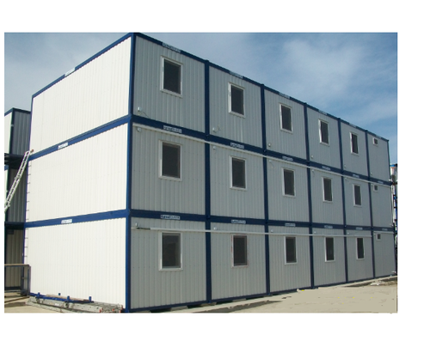
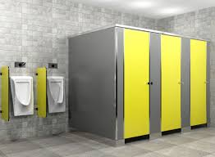
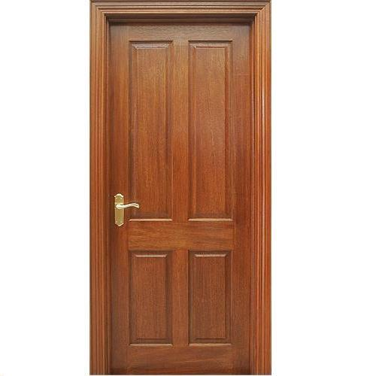
Whether immovable property?
Pre-Fabricated Buildings
Restroom Cubicles
Doors/Windows etc.
Storage Tanks

Slide 93
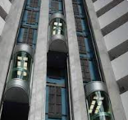
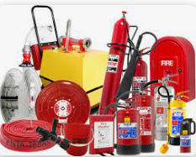
Whether Plant & Machinery?
Lifts
Fire Fighting Equipment
DG Sets
CCTV

Slide 94
Advance rulings
Jabalpur Hotels Private Limited
GST Credit denied on procuring the lift to be installed in hotel building which in turn is intended to be used for providing taxable service. Considering definition of P&M, the Authority observed that lift became part of the building
Notes:
25. In Re_M_s. Jabalpur Hotels Private Limited

Slide 95
Advance Rulings
Tarun Realtors Private Limited (AAAR)
Chiller, Air Handling Unit, Indoor/Outdoor Surveillance System (CCTV), electrical wiring and fixtures, Public Health Engineering (PHE), Fire-fighting and water management pump system are items which are procured for the purpose of construction of the immovable property.
Lift and Car park system – Held to be Plant and Mahinery. However, since appellant is not undertaking construction/installation of the same, credit will not be allowed.
Water Treatment Plant, DG Sets and Transformers become part of civil structure of immovable property. Hence, ITC is not available
Notes:
26. In Re_ M_s. Tarun Realtors Pvt. Ltd_

Slide 96
Advance Rulings
Wework India Management (AAAR)
ITC on detachable sliding glass partitions. Fixed to the ground with the help of nuts and bolts and could be dismantled and moved as per requirements of customer. Held to be movable and ITC allowed by AAAR.
Notes:
27. In Re_ M_s. Wework India Management Private Limited

Slide 97
Telecommunication Towers- ITC Availability?
Vodafone Mobile Services Limited v. Commissioner of Service Tax (2018 VIL 506 DEL CE)
The Delhi High Court held that a machine or apparatus annexed to the earth without its assimilation by fixing with nuts and bolts on a foundation to provide for stability and wobble free operation cannot be said to be one permanently attached to the earth and therefore, would not constitute an immovable property.
Bharti Airtel Ltd. v. CCE, Pune-III (2014 (35) S.T.R. 865)
In the Bharti Airtel case, the Hon’ble Bombay High Court held that the towers were immovable property and has accordingly denied the credit.
Hon’ble high court relied on the judgement of Central Excise v. Solid and Correct Engg Works
The decision of the Hon’ble Bombay High Court has been challenged before the Hon'ble Supreme Court in Civil Appeal Nos. 10409-10410 of 2014
Decision pending before SC
Notes:
28. Vodafone Mobile Services Limited 29. M_s. Bharti Airtel Ltd.

Slide 98
Construction contracts – Whether Credit Admissible?
Single contract for construction of building/office on turnkey basis
Whether composite supply of construction of immovable property?
Availability of ITC on movable items like furniture, lighting fixtures etc.?
ITC available on items which qualify as plant and machinery items like HVAC system, UPS System, CCTVs, Fire Alarm System etc.?
Similarly, in cases involving construction of factory building, the foundation of the plant and machinery may be constructed under the same contract.

Slide 99
Construction contracts
Separate contract/POs for construction of building/office
Whether the contracts/POs are interlinked?
Is there any cross-fall breach clause?
Classification adopted by the vendor – will it have any bearing on the credit?
For instance, contract with vendor for supply of lighting fixtures but vendor issues invoice for works contract service

Slide 100
Construction of Immovable Property for letting out-ITC?
M/S. Safari Retreats Private Limited and another Versus Chief Commissioner of Central Goods & Service Tax & Others- Orissa High Court- Pending before HC
CGST Act: Section 17(5)(d) provides that credit shall not be available on goods or services or both received by a taxable person for construction of an immovable property (other than plant or machinery) on his own account including when such goods or services or both are used in the course or furtherance of business.
Decision: Section 17 (5) to be read down and narrow restriction as imposed by department is not required to be accepted. The purpose of the credit is to give benefit to the assessee. Held that if the assessee is required to pay GST on the rental income arising out of the investment on which he has paid GST, it is required to have the input credit on the GST, which is required to pay under Section 17(5)(d) of the CGST Act.
Notes:
30. M_s. Safari Retreats Private Limited

Slide 101
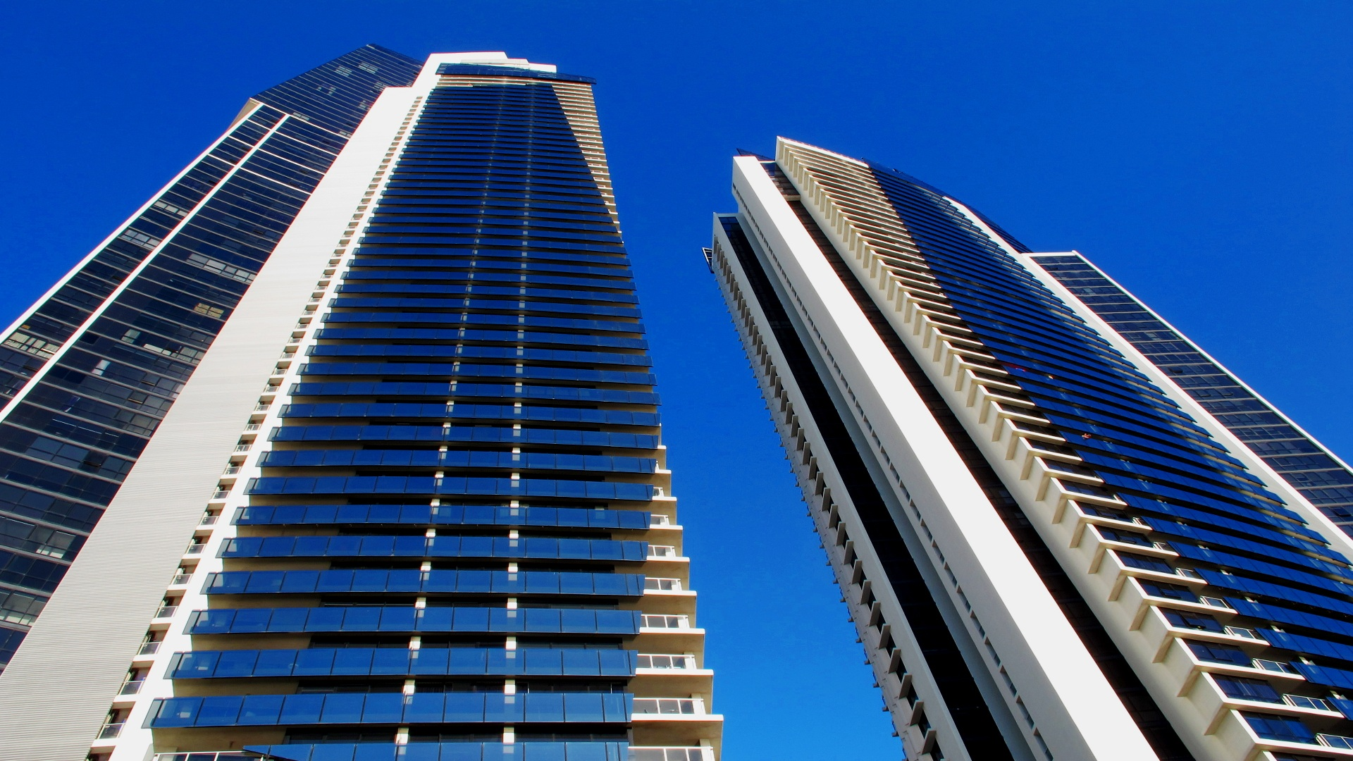
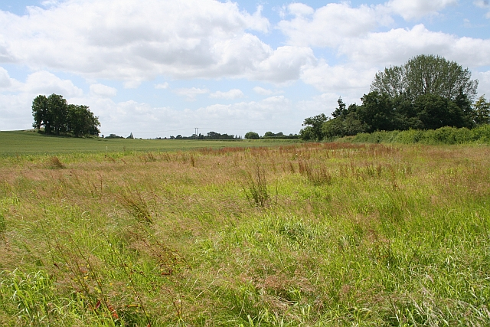
Leasehold Rights
Leasehold Rights obtained in respect of land
Construction of Building
Notes:
31. HUL_LO_ITC availability on leasehold rights

Slide 102
Issues
Whether ITC available in respect of leasehold rights?
Whether restricted under Section 17(5)(d)?
Scope of ‘for construction’- wide?
Link with construction activity essential?
Scope of Section 17(5)(d) to be read as restrictive or can it be expanded?

Slide 103
Relevant Decisions
In the case of Daicel Chiral Technologies (India) Pvt. Ltd., AAR disallowed ITC on payment of Lease Premium Charges (one-time charges) and annual Lease rentals (recurring) towards land lease stating that the same is ‘for construction’ under Section 17(5)(d) of the CGST Act.
GGL Hotel and Resort Company Limited, the AAR held that the prohibition from availing input tax credit, as provided under section 17(5)(d) of the GST Act extends to the immovable property in general (other than plant and machinery), which includes the supplies received for retaining the right to use and develop the land. Such supplies are essential for construction of the civil structure on the piece of land. Input Tax Credit is not available to the Applicant for lease rent paid during pre-operative period for the leasehold land on which the resort is being constructed on his own account to be used for furtherance of business, when the same is being capitalised and treated as capital expenditure in view of Section 17(5)(d) of the CGST Act. The said view was later affirmed by AAAR.
Notes:
32. Daicel Chiral Technologies (India) Private Limited
33. GGL Hotel And Resort Company Limited
21. M_s. GGL Hotel And Resort Company Limited AAAR

Slide 104
Taxability on Cancellation charges

Slide 105
Cancellation Charges
AIRLINES
RAILWAYS
HOTELS
EVENTS
TOUR OPERATORS

Slide 106
Cancellation Charges
Obligation to tolerate an act?
Penalty/Damages = NO GST?
Schedule II(e)- Agreeing to the obligation to refrain from an act, or to tolerate an act or a situation, or to do an act?

Slide 107
Treatment of amount paid as liquidated damages
Liquidated damages -non-performance
and the breach of contract
Compensation for any loss or damage caused
Supply?
Nature of supply? Same as main supply or a separate service?

Slide 108
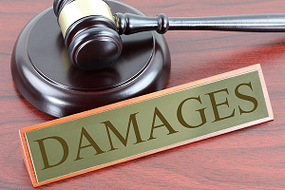
Concept of Toleration and Penalty / Damages
Toleration
Includes
Prior intention to tolerate.
Pre-existing agreement between the parties
Existence of contractual understanding.
Request by service receiver to tolerate an act.
Does not include:
Amount paid for the defaults / breach committed under a contract.
Compensation to make good loss of the damages.
Mere flow of money

Slide 109
Indian Judicial Precedents
Lemon Tree- Service tax demand was proposed on cancellation charges as declared services under Section 66E(e) of Finance Act. It was held that the customers paid amount to hotel for hotel accommodation services, and out of such amount whole or part of advance received for booking of hotel room, was retained by Hetal as the Hotel had kept its services available for the accommodation. It was held that the retention amount (on cancellation made by the customer) does not undergo a change and therefore, no service tax was attracted under Section 66E(e).
Jaipur Jewellery Show - Liability of Service Tax on cancellation charges retained from persons, who initially book their booth in the exhibitions organized by the assessee but cancel the same later on. It was held by the Hon’ble Tribunal that such cancellation charges are not towards rendition of any services and thus, are not liable to Service Tax.
British Airways PLC India Branch v. Commissioner- Refund administration charges/ cancellation charges are in the form of penalties and not towards provision of any service and thus not taxable
Notes:
34. M_s Lemon Tree Hotel
35. British Airways Plc India Branch

Slide 110
Department Clarification
​ | Advance forfeited for cancellation of an agreement to provide a service​ | Since service becomes taxable on an agreement to provide a service such forfeited deposits would represent consideration for the agreement that was entered into for provision of service.​
​ | Security deposits forfeited for damages done by service receiver in the course of receiving a service​ | If the forfeited deposits relate to accidental damages due to unforeseen actions not relatable to provision of service then such forfeited deposits would not be a consideration in terms​ ​

Slide 111
Circular 178/10/2022-GST
Cancellation Charges
Cancellation fee -charges for the costs involved in making arrangements for the intended supply and the costs involved in cancellation of the supply, such as in cancellation of reserved tickets by the Indian Railways
The facilitation service of allowing cancellation against payment of cancellation charges is also a natural part of this bundle. It is invariably supplied by all suppliers of passenger transportation service as naturally bundled and in conjunction with the principal supply of transportation in the ordinary course of business
Facilitation supply of allowing cancellation of an intended supply against payment of cancellation fee or retention or forfeiture of a part or whole of the consideration or security deposit in such cases should be assessed as the principal suppl
Taxable at the same rate as the rate applicable to the service contract.
Validity?
Notes:
36. cir-1782022

Slide 112
Tax Paid voluntarily or under Protest

Slide 113
Section 17(5)(i)
Section 17(5)(i)
any tax paid in accordance with the provisions of sections 74, 129 and 130.
Rule 36(3)
No input tax credit shall be availed by a registered person in respect of any tax that has been paid in pursuance of any order where any demand has been confirmed on account of any fraud, wilful misstatement or suppression of facts

Slide 114
Section 17(5)(i)
Whether ITC can be denied in following cases?
Penalty paid for equivalent percentage as provided under Section 74, without admission of liability?
Tax Paid in pursuance of investigation/audit conducted by the department
Tax Paid in pursuance of Show cause notice conducted by the department
IGST paid on imports- even in cases involving fraud
Notes:
37. Availability of ITC on differential IGST paid at a subsequent stage on import of goods (Note)
ITC not available
Available
Available
Available-can be argued (Note)

Slide 115
ITC of Tax Paid under Protest
Northern Operating
Decision
Issue Raised
Overseas Group Companies providing manpower supply services to NOSPL?
Decision
Taxable - Import of Services
Tax Paid by Taxpayers under Protest?
No specific provisions for payment under Protest
ITC availability?
Notes:
38. Northern Operating Systems

Slide 116
Documents for availing ITC
RULE 36. Documentary requirements and conditions for claiming input tax credit. — (1) The input tax credit shall be availed by a registered person, including the Input Service Distributor, on the basis of any of the following documents, namely, -
(a) an invoice issued by the supplier of goods or services or both in accordance with the provisions of section 31;
(b) an invoice issued in accordance with the provisions of clause (f) of sub-section (3) of section 31, subject to the payment of tax;
(c) a debit note issued by a supplier in accordance with the provisions of section 34;
(d) a bill of entry or any similar document prescribed under the Customs Act, 1962 or rules made thereunder for the assessment of integrated tax on imports;
(e) an Input Service Distributor invoice or Input Service Distributor credit note or any document issued by an Input Service Distributor in accordance with the provisions of sub-rule (1) of rule 54.

Slide 117
Other instances of Differential GST Payment
IGST payment on imported goods subsequent to filing of BOE
Payment of IGST at the time of surrender of exemption claimed under Advance Authorization consequent to claiming IGST refund due to Rule 96(10)
Payment of IGST due to non-fulfillment of pre-import condition
ITC eligibility
Debit note cannot be issued under Sec 34 as there is no corresponding tax invoice
Payment made vide TR-6 Challan, basis which credit consistently allowed under the erstwhile Cenvat Credit Rules
Public Notice No. 48/2023 dated 9.6.2023 issued by Commissioner of Customs, clarified the requirement of re-assessing the bill of entry for availing IGST credit
Can credit availed in past basis TR-6 challan be disputed by department?
Notes:
39. In Re_ M_s. Golden Tobacco Ltd_
40. GRB Dairy Foods-
41. JSPL - note on ITC on differential tax paid_19.07

Slide 118
Issuance of Commercial Credit Note

Slide 119
Credit Note under GST
Whether issuance of Credit Note is Mandatory?
Section 34 (1)
Where one or more tax invoices have been issued for supply of any goods or services or both and the taxable value or tax charged in that tax invoice is found to exceed the taxable value or tax payable in respect of such supply, or where the goods supplied are returned by the recipient, or where goods or services or both supplied are found to be deficient, the registered person, who has supplied such goods or services or both, may issue to the recipient one or more credit notes for supplies made in a financial year containing such particulars as may be prescribed.

Slide 120
Reversal of credit under 16(2)?
Second proviso to Sec 16(2)
Provided further that where a recipient fails to pay to the supplier of goods or services or both, other than the supplies on which tax is payable on reverse charge basis, the amount towards the value of supply along with tax payable thereon within a period of 180 days from the date of issue of invoice by the supplier, an amount equal to the input tax credit availed by the recipient shall be added to his output tax liability, along with interest thereon, in such manner as may be prescribed.
Whether recipient is required to reverse credit on account of commercial credit note?

Slide 121
Reversal of credit under 16(2)?
M/s MRF Limited - AAR, Tamilnadu
The Applicant can avail Input Tax Credit only to the extent of the invoice value less the discounts as per credit note. If he has availed input tax credit on the full amount, he should reverse the difference amount equal to the discount, to avoid adding to his output liability.
M/s MRF Limited, - Appellate AAR, Tamilnadu and M/S. Santhosh Distributors - AAR, Kerala
A conjoint reading of Sections 15 and 16 leads to the conclusion that a registered person is entitled to take full credit of the input tax charged on the supply of goods or services or both. The provisions of the second proviso to section 16(2) would come into play only where the buyer/ recipient fails to pay the supplier of goods the amount towards the value of the supply. This is not the situation here. The buyer has discharged the GST charged on the undiscounted transaction value at the time of supply. In the circumstances, if the GST charged and paid is not reversed/ refunded in whole or part subsequently in any manner or circumstances, the credit availed on the same need not be reversed.
Notes:
42. In Re_ M_s. MRF Ltd.-AAR
43. In Re_ M_s. MRF Ltd.-AAAR
44. In Re_ M_s. Santhosh Distributors

Slide 122
Implications if credit not reversed by recipient?
Proviso to Section 34(2)
Provided that no reduction in output tax liability of the supplier shall be permitted, if the incidence of tax and interest on such supply has been passed on to any other person.
Commissioner of Central Excise, Madras Vs Addison & Co. Ltd. - 2016 (339) E.L.T. 177 (SC) Affirmed by Addison and Co. Ltd. v. Commissioner - 2017 (353) E.L.T. A64 (SC)
Since duty component on turnover discount was initially passed onto buyer who further passed it onto ultimate consumer who could not be identified, refund of such duty claimed by assessee on the plea that such duty returned back by issuing credit notes subsequent to clearance of goods was not admissible being hit by bar of unjust enrichment under Section 12B of the Central Excise Act, 1944.
It was further held that the downstream buyers/ultimate consumers can also make claim for refund of duty paid in excess.
Notes:
45. M_s Addison & Co. Ltd_ “SECTION 34. (1) Where one or more tax invoices have been issued for supply of any goods or services or both and the taxable value or tax charged in that tax invoice is found to exceed the taxable value or tax payable in respect of such supply, or where the goods supplied are returned by the recipient, or where goods or services or both supplied are found to be deficient, the registered person, who has supplied such goods or services or both, may issue to the recipient one or more credit notes for supplies made in a financial year containing such particulars as may be prescribed.”
Section 34(1) to be read harmoniously with Section 15
Can be issued only if conditions mentioned under Section 15(3)(b) are fulfilled

Slide 123
Implications if credit not reversed by recipient?
Section 15(3)(b)(ii)
The value of the supply shall not include any discount which is given after the supply has been effected, if input tax credit as is attributable to the discount on the basis of document issued by the supplier has been reversed by the recipient of the supply.
Section 42 and 43
Reduction of every claim of supplier will be matched with claim of recipient for reversal
Where the claim matches, the reduction will be accepted.

Slide 124
ISD v Supply (Cross Charge)

Slide 125
ISD vs. Supply
CREDIT ON INPUT SERVICES
Mere invoice received by office,
input service received by other units
Input service received by office for providing
support function to other units
ISD
Supply (Cross Charge)
Value of invoice?
Value of invoice?
Full ITC available
Full ITC not available to the recipient

Slide 126
Significant Rulings on ISD vs. SUPPLY
CUMMINS INDIA LIMITED [2022 (58) GSTL 549 (AAAR – Maharashtra)
Common input services received by HO but consumed by branch: HO is not entitled to avail ITC
ISD : mandatory for HO for the distribution of credit in spite of supply invoice
For Supply: value (second proviso of Rule 28 of the CGST Rules)
Colombia Asia Hospitals Pvt Ltd [2019 (20) GSTL 763 AAAR]
Services provided by employees of HO to BO
HO shall include the cost of salaries paid to employees for services by HO to BOs
Services commonly used by all distinct persons: ITC distribution by ISD
Notes:
2. CUMMINS INDIA LIMITED [2022 (58) GSTL 549 (AAAR – Maharashtra)
46. Re_ M_s. Columbia Asia Hospitals Pvt. Ltd_

Slide 127
Circular No. 199/11/2023-GST Dated 17.07.2023
Nature of services | Issue | Clarification
Services procured from 3rd parties by HO attributable to HO and BO(s) /only BO(s) | ISD - Mandatory? Can HO avail credit and Supply? | ISD not mandatory HO has option to distribute ITC through ISD or raise invoice under Section 31 to BO(s) Subject to BO(s) actually receiving the services Whether HO can avail credit? : Not answered
Notes:
47. Circular No. 199/2023

Slide 128
Circular No. 199/11/2023-GST Dated 17.07.2023
Nature of services | Issue | Clarification
Internally generated services by HO to BO(s) | BO(s) eligible for full ITC Valuation? Is it mandatory to include costs such as employee salary etc.? Is it mandatory to issue tax invoices? | Valuation (second proviso to Rule 28) Value declared in invoice deemed to be OMV (whether employee cost/ other costs included or not). If invoice not raised, value may be deemed to be declared as Nil – OMV
 | BO(s) not eligible for full ITC Is it mandatory to include employee cost? | Not mandatory to include the cost of salary of employees in the value of supply of service to BO(s) What value to take?: Not answered

Slide 129
Areas requiring attention (1/3)
Impact on incorrect distribution of credit in the past. Is correction required?
Impact on ongoing litigations involving wrong distribution of ITC
Can ISD registration taken in the past be discontinued now?

Slide 130
Areas requiring attention (2/3)
Applicability on valuation in case of related parties
Applicability of circular on reverse charge transactions
Value where full ITC is not admissible? Rule 28 (such as cost +10%) or cost?

Slide 131
Areas requiring attention (3/3)
Whether perquisites can also be included under ‘Salary’?
Transfer of CGST/SGST as IGST by raising supply invoice?
Applicability of circular on stock transfers – ITC accumulation

Slide 132
Reversals under Rule 42

Slide 133
Rule 42 illustration
Particulars | Symbol | Amount (Rs.)
Total ITC available | T | Rs. 70,000/-
Input tax credit exclusively used for “non-business purpose” | T1 | Rs. 10,000/-
Input tax credit exclusively used for “exempt supplies” (e.g. supply of non-scheduled power to grid) | T2 | Rs. 10,000/-
Non-eligible credit [Section 17(5) of the CGST Act] | T3 | Rs. 10,000/-
Input tax credit credited to electronic ledger C1 = T – (T1+T2+T3) C1 = 70,000 – (10,000+10,000+10,000) =40,000 | C1 | Rs. 40,000/-
Input tax credit exclusively used for taxable supply | T4 | Rs. 15,000/-
Common credit C2 = C1- T4 C2 = 40,000 -15,000 | C2 | Rs. 25,000/-

Slide 134
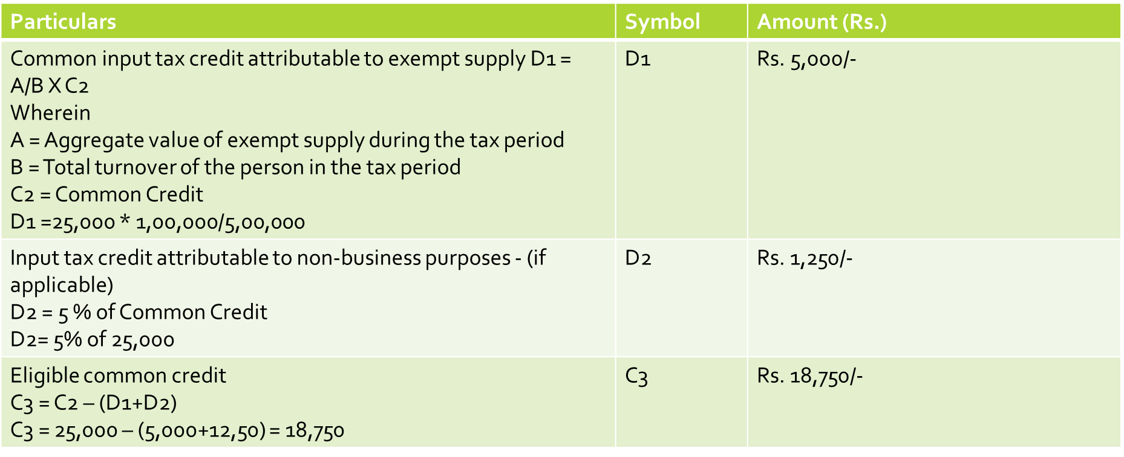
Rule 42-illustration
Above calculation of reversal is required to be carried out for each tax period i.e. for each month and reported in GSTR 3B filed for the said month.

Slide 135
Calculation of Reversal
The amount of input tax credit attributable towards exempt supplies, be denoted as ‘D1‘ and calculated as-
D1= (E÷F) × C2
where,
‘E‘ is the aggregate value of exempt supplies during the tax period, and
‘F‘ is the total turnover in the State of the registered person during the tax period”
“C2” = The amount of common credit involved on inputs and input services in a tax period
“Tax period’ = Period for which the return is required to be furnished.
Whether the credit availed during the particular month in which the exempt supply is made would be considered for calculating the amount of credit as attributable to exempt supply?

Slide 136
Calculation of Reversal Amount
Rule 42(2)-Except in case of supply of services covered by clause (b) of paragraph 5 of the Schedule II of the Act, the input tax credit determined under sub-rule (1) shall be calculated finally for the financial year before the due date for furnishing of the return for the month of September following the end of the financial year to which such credit relates, in the manner specified in the said sub-rule
where the aggregate of the amounts calculated finally in respect of ‘D₁’ and ‘D₂’ exceeds the aggregate of the amounts determined under sub-rule (1) in respect of ‘D₁’ and ‘D₂’, such excess shall be reversed by the registered person in FORM GSTR-3B or through FORM GST DRC-03 in the month not later than the month of September following the end of the financial year to which such credit relates and the said person shall be liable to pay interest on the said excess amount at the rate specified in sub-section (1) of section 50 for the period starting from the first day of April of the succeeding financial year till the date of payment; or
where the aggregate of the amounts determined under sub-rule (1) in respect of ‘D₁’ and ‘D₂’ exceeds the aggregate of the amounts calculated finally in respect of ‘D₁’ and ‘D₂’, such excess amount shall be claimed as credit by the registered person in his return for a month not later than the month of September following the end of the financial year to which such credit relates.

Slide 137
Calculation of Reversal Amount- Issue
Whether for calculation of aggregate amount of D1 finally for the financial year, the turnover and other details to be considered on monthly basis during which exempt supply was effected or the details are required on financial year basis?

Slide 138
Relevant Provisions
Section 17(2)-
“(2) Where the goods or services or both are used by the registered person partly for effecting taxable supplies including zero-rated supplies under this Act or under the Integrated Goods and Services Tax Act and partly for effecting exempt supplies under the said Acts, the amount of credit shall be restricted to so much of the input tax as is attributable to the said taxable supplies including zero-rated supplies.”
(3) The value of exempt supply under sub-section (2) shall be such as may be prescribed, and shall include supplies on which the recipient is liable to pay tax on reverse charge basis, transactions in securities, sale of land and, subject to clause (b) of paragraph 5 of Schedule II, sale of building.
For the purposes of this sub-section, the expression “value of exempt supply” shall not include the value of activities or transactions specified in Schedule III, except those specified in paragraph 5 of the said Schedule.

Slide 139
Scope of “Transaction in Securities”
Her Majesty’s Commissioners of Inland Revenue v. Laird Group Plc. [2003] UKHL 54],
With respect to interpretation of the phrase, ‘transaction in securities’, the Court held that as a matter of ordinary language, the creation, issue, sale, purchase, exchange, redemption and extinguishment of shares or debentures were all “transactions in securities”. In each case the securities themselves were the subject-matter of the transaction. Securities included stocks, shares, debentures and unsecured loans.
Income and Corporation Taxes Act, 1988 [UK]
2) ... “transaction in securities includes transactions, of whatever description relating to securities and in particular-
(i) the purchase, sale or exchange of securities;
(ii) the issuing or securing the issue of, or applying or subscribing for, new securities;
(iii) the altering, or securing the alteration of, the rights attached to securities...”
Notes:
48. House of Lords - Her Majesty's Commissioners of Inland Revenue v. Laird Group plc -

Slide 140
Redemption of Mutual Funds
Whether the term “transaction in securities’ is wide enough to cover any transaction related to such security?
Whether the scope of exempted supplies prescribed under Section 17(3) is not restricted only to trading (i.e. buying and selling) of securities or includes any ‘transaction’ undertaken in respect of securities?
Explanation to Chapter-V
For determining the value of an exempt supply as referred to in sub-section (3) of section 17 -
(a) the value of land and building shall be taken as the same as adopted for the purpose of paying stamp duty; and
(b) the value of security shall be taken as one per cent. of the sale value of such security
Whether ITC reversal on common services required in case the entity is engaged in trading in shares, mutual fund units, etc? -Possibility of arguing that redemption of securities not covered under above?

Slide 141
Dividend Income
SCRA Act
“(i) shares, scrips, stocks, bonds, debentures, debenture stock or other marketable securities of a like nature in or of any incorporated company or other body corporate;
(ii) derivative;
(iii) units or any other instrument issued by any collective investment scheme to the
investors in such schemes;
(iv) security receipt as defined in clause (zg) of Section 2 of the Securitisation and
Reconstruction of Financial Assets and Enforcement of Security Interest Act, 2002;
(v) units or any other such instrument issued to the investors under any mutual fund
scheme;
(vi) Government securities;
(vii) such other instruments as may be declared by the Central Government to be
securities; and
(viii) rights or interest in securities.
Whether Dividend is included under the term “security” or “transaction in securities”?

Slide 142
Committed to International Standards in Information Security
LOCATIONS
New Delhi
Lsdel@lakshmisri.com
Mumbai
Lsbom@lakshmisri.com
Chennai
Lsmds@lakshmisri.com
Bengaluru
Lsblr@lakshmisri.com
Hyderabad
Lshyd@lakshmisri.com
Ahmedabad
Lsahd@lakshmisri.com
Pune
Lspune@lakshmisri.com
KOLKATA
Lskolkata@lakshmisri.com
CHANDIGARH
Lschd@lakshmisri.com
GURUGRAM
Lsgurgaon@lakshmisri.com
PRAYAGRAJ (Allahabad)
Lsallahabad@lakshmisri.com
KOCHI
Lskochi@lakshmisri.com
JAIPUR
Lsjaipur@lakshmisri.com
NAGPUR
Lsnagpur@lakshmisri.com
THANK YOU!
FOR any support or information write to:
km@lakshmisri.com

